Slide 1

Car Accident severity prediction Applied Data Science capstone Project
KARISHMA RAO MOKIRALA

Slide 2
Business Problem
Road traffic accidents cause millions of deaths and injuries every year globally
Road traffic injuries cause significant economic losses - costs most countries 3% GDP
Insights on factors leading to high accident injury risk provide valuable guidance for public traffic polices
Also benefits public individuals for safer road trips

Slide 3
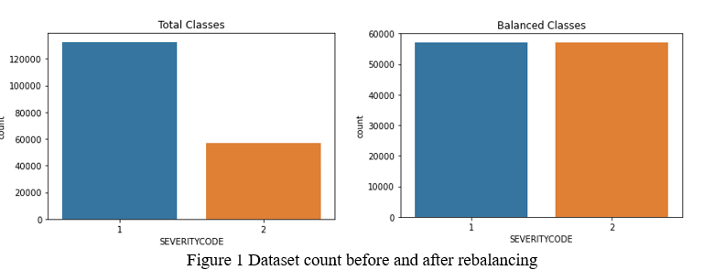
Data Engineering
Example dataset was used with goal to predict accident severity (code1-property, code 2-injury)
Dataset rebalanced by under-sampling to reduce model bias
Unmatched data and duplicated columns were dropped
Data rows with missing entries were dropped

Slide 4
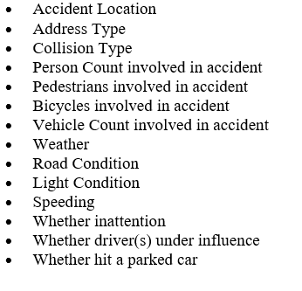
Feature Selection
14 attributes initially selected for data analysis & understanding

Slide 5
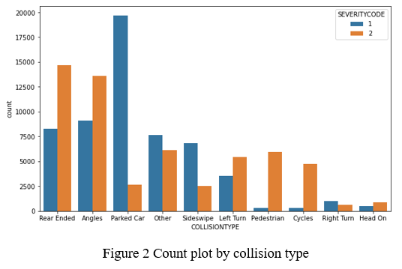
Data Analysis- Collision Type
Pedestrian, cycle involvement indicate higher chance of injury
Hit-a-parked-car indicate lower chance of injury
Above 3 attributes were selected for model

Slide 6
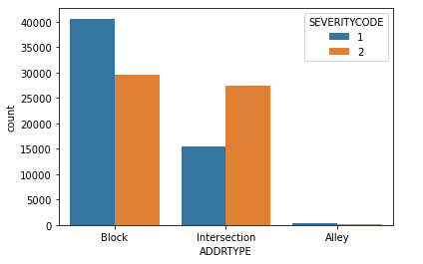
Data Analysis- Address Type
Accidents happen more frequently at block
Accidents at intersection are more likely to cause injury

Slide 7
Data Analysis – Driving Condition
Weather, road condition, light condition attributes: processed with simplified categories, converted to ordinal numbers based on risk
e.g. 1-bright daylight, 2-dust/dawn, 3-dark with lights on, 4-dark with no light
Correlation between weather and road condition (R-squared 0.61), only one attribute “weather” was selected for model

Slide 8
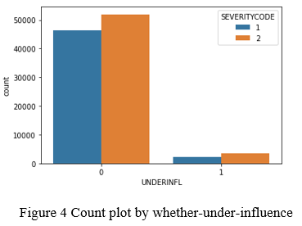
Data Analysis – Driving Behavior
Speeding, inattention, under-influence attributes: missing data entry was interpreted as “N” and converted to binary 0 or 1; all selected for model
Higher chance of causing injury (60%) if driver under influence

Slide 9
Decision Tree Model
11 features were selected for model
Decision tree selected for advantages in reflecting importance ranking of features in hierarchy, and ease of interpretation
Recall score is of particular interest as for rare event prediction like road accident prediction or medical diagnosis, it is preferred to have a higher recall (even with more false positives)

Slide 10
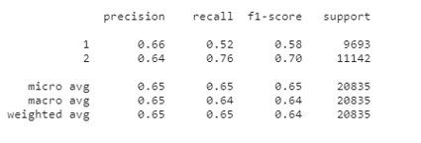
1st Model & Performance
1st round with all features included
Model accuracy of 0.65
Recall for predicting injury is 0.76

Slide 11
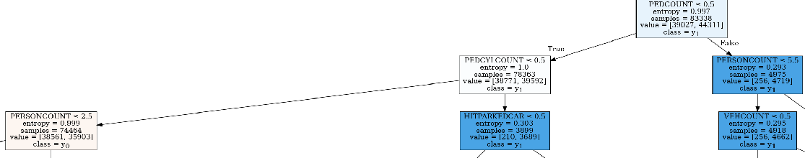
Result Discussion & Recommendation
Most important features: pedestrians, bicycles, person-count involved in accidents; followed by vehicle count involved and hit-a-parked-car situation
Public traffic polices are recommended with more protection of pedestrians & bicycles on roads like having more marked crosswalks, bike lanes, pedestrian having right of way, more road warning signs for pedestrian and bicycles passing, etc.

Slide 12
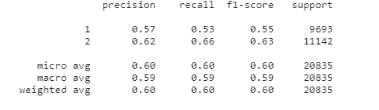
2nd Model & Performance
Only potential accident cause factors included in 2nd model: address type, driving conditions & behavior
Model accuracy of 0.60
Recall for predicting injury is 0.66

Slide 13
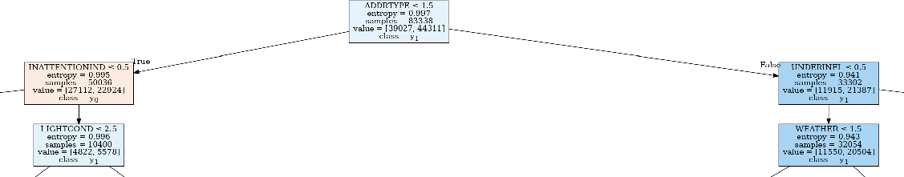
Result Discussion & Recommendation
Most importance features: address type, driver under-influence, inattention; followed by speeding, light condition & weather
Intersection is highly susceptible for severe accidents with injuries
Dangerous driving behaviors more likely to cause injuries especially under less favorable driving conditions
Recommend to have better intersection design with increased visibility, more guidance signs; reinforced public education of safe driving, strict punishment measures to prevent dangerous driving behaviors

Slide 14
Conclusion & Future Study
Useful and informative models built to predict accident severity
Value in guiding public traffic polices to focus on important factors to prevent accident injuries
Accuracy of model has room for improvement, more insights could be gained
Collision type be further processed and used in model
Accident address be grouped based on injury occurrence ratio and used in model
Accident trend by dates

